Slide 1
BIOL 3110: Conservation and Ecological Genetics
Tutorial 1

Slide 2
Tutorial Schedule
Wk8 – Q & A about Assessments
Wk9 – Seminar (Part 1)
Wk10 – Seminar (Part 2)
Wk11 – Prob. Set 4
Wk12 – Prob. Set 5
Wk13 – Prob. Test 2
Wk3 – Prob. Set 1
Wk4 – Prob. Set 2
Wk5 – Prob. Set 3
Wk6 – Prob. Test 1
BREAK
Wk7 – Computer Prac.

Slide 3
Mendelian inheritance: If two parents have genotypes of A₁A₂ and A₁A₂ at a single locus, what are the expected frequencies of the different progeny genotypes?

Slide 4
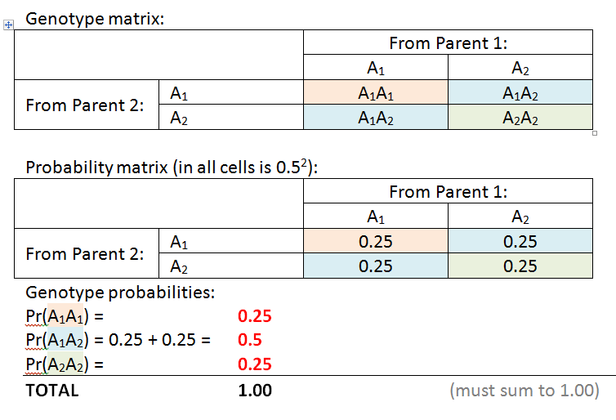
Mendelian inheritance: If two parents have genotypes of A₁A₂ and A₁A₂ at a single locus, what are the expected frequencies of the different progeny genotypes?

Slide 5
Mendelian inheritance: If two parents have genotypes of A₁A₂ and A₁A₂ at a single locus, what are the expected frequencies of the different progeny genotypes?

Slide 6
Mendelian inheritance: If two parents have genotypes of A₁A₂ and A₁A₂ at a single locus, what are the expected frequencies of the different progeny genotypes?

Slide 7
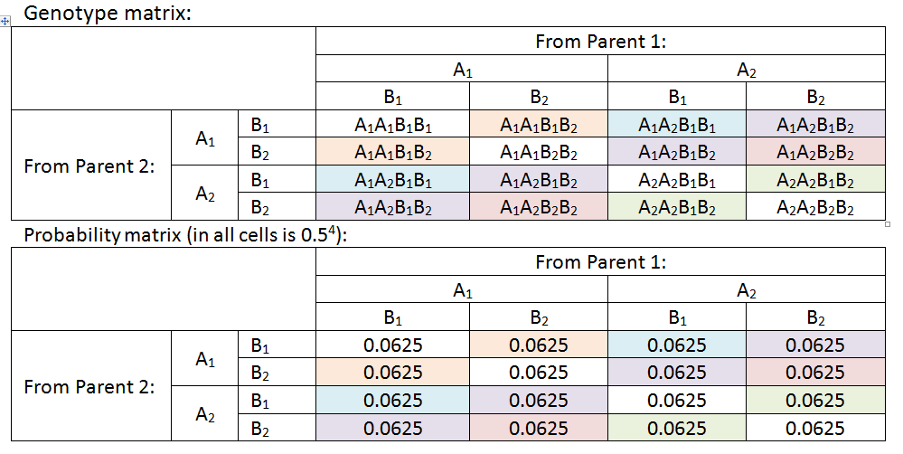
Mendelian inheritance: What are the expected proportions of the different progeny genotypes produced from the cross between A₁A₂ B₁B₂ and A₁A₂ B₁B₂ parents, assuming independent assortment of the A & B loci?

Slide 8
Mendelian inheritance: What are the expected proportions of the different progeny genotypes produced from the cross between A₁A₂ B₁B₂ and A₁A₂ B₁B₂ parents, assuming independent assortment of the A & B loci?

Slide 9
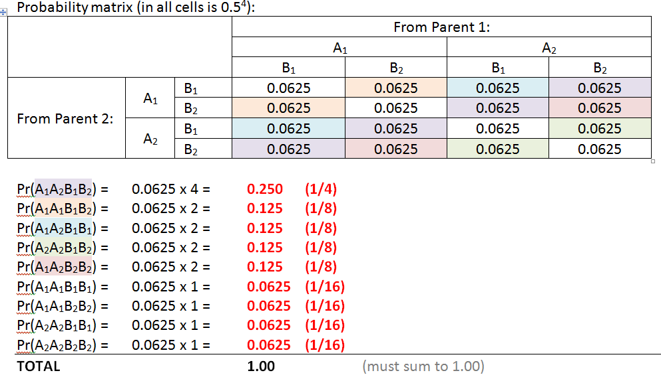
Genotypic Frequency

Slide 10
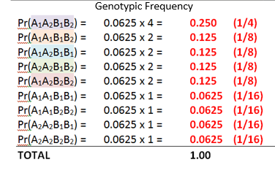
Mendelian inheritance: What is the phenotypic ratio?
Phenotypic Frequency
A₁ B₁ | 9
A₁ B₂ | 3
A₂ B₁ | 3
A₂ B₂ | 1

Slide 11
Statistics. The four phenotypes in an F2 were found in the numbers 100:20:35:5. Use a chi-squared test to determine whether these differ from the 9:3:3:1 expectation.
 | Observed counts | Expected ratio
P1 | 100 | 9
P2 | 20 | 3
P3 | 35 | 3
P4 | 5 | 1
Sum | 160

Slide 12
Chi squared
What does it measure?
Measures how different a set of data is to what is expected.
X² = ∑(Obs-Exp)² / Exp
Observed: the data
Expected: Genetic expectations from Mendel’s laws (or any other theoretical model)

Slide 13
Statistics. The four phenotypes in an F2 were found in the numbers 100:20:35:5. Use a chi-squared test to determine whether these differ from the 9:3:3:1 expectation.
 | Observed counts | Expected ratio | Expected counts | (obs-exp)²/exp
P1 | 100 | 9 | 90
P2 | 20 | 3 | 30
P3 | 35 | 3 | 30
P4 | 5 | 1 | 10
Sum | 160 |  | 160
This is what we’d expect if we had 16 indvs. but we don’t (we have 160), so have to x it

Slide 14
Statistics. The four phenotypes in an F2 were found in the numbers 100:20:35:5. Use a chi-squared test to determine whether these differ from the 9:3:3:1 expectation.
 | Observed counts | Expected ratio | Expected counts | (obs-exp)²/exp
P1 | 100 | 9 | 90 | 1.111
P2 | 20 | 3 | 30 | 3.333
P3 | 35 | 3 | 30 | 0.833
P4 | 5 | 1 | 10 | 2.500
Sum | 160 |  | 160 | 7.778

Slide 15
χ² Test: Degrees of Freedom (df)
Ordinary chi-square tests:
Df = Number of categories tested - 1
In this instance as there are 4 phenotypes our df = 3

Slide 16
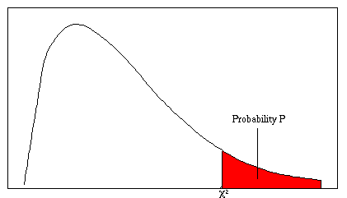
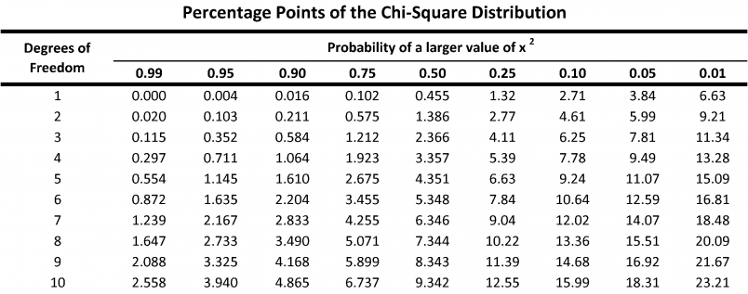
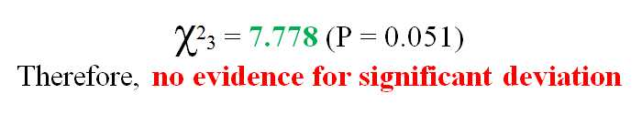
Chi squared table
Df = No. of categories -1
(4 phenotypes)

Slide 17
Chi squared Value
When χ² is higher than crit. value, then P is less than 0.05 = significant difference
When χ² is lower than crit. value, then P is greater than 0.05 = NO significant difference

Slide 18

Transcription and translation:
Summary of DNA to protein process:
https://www.youtube.com/watch?v=gG7uCskUOrA&t=15s
 | Codons |  |  |  | Notes
Complimentary DNA | ATG | AAA | CCC | TAA | Inverse of coding strand
Coding DNA strand | TAC | TTT | GGG | ATT |  | Transcription
mRNA | AUG | AAA | CCC | UAA | Identical to non-coding strand except that U (Uracil) replaces T (Thymine)
tRNA anticodon | UAC | UUU | GGG | AUU | Inverse of mRNA. Binds to protein at one end and locks with mRNA at other | Translation
Amino acids | Met | Lys | Pro | - | Read from the mRNA.*Note UAA is read as a ‘stop’ codon
Notes:
Always starts with methionine!

Slide 19
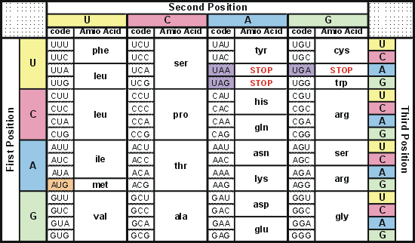
Codon Table

Slide 20

IUCN Red list search: Navigate to the IUCN red list website (http://www.iucnredlist.org/). Use the “other search options” tab
(next to the search field) to run a search for information on the
following:
Taxonomy: Mammals (native)
Location: Queensland, Australia
Habitat: Forest - Subtropical/Tropical Moist Lowland
Taxonomy: Native members of the butterfly (Lepidopteran) family Lycaenidae
Location: Australia
Assessment: Categories EX (extinct) and EW (extinct in the wild)
Location: Australia
(a) How many species does your search reveal in each case?

Slide 21

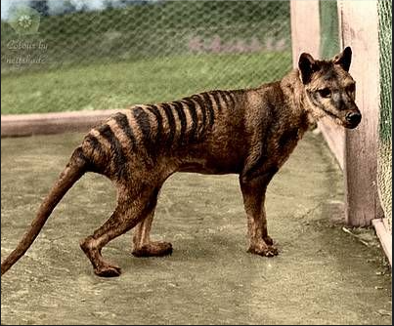
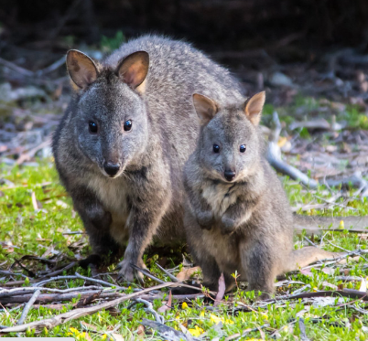
1.5 IUCN Red list search. Continued…
(b) Pull up the fact sheet for the Thylacine (Tasmanian Tiger) and find the justification for its listing. When was the last confirmed record of this species:
(b.1) In the wild?
(b.2) In captivity?
(c) Do you think this species’ IUCN listing is justified? What are your personal thoughts?

Slide 22
Genetic Diversity, Allele counting and Hardy-Weinberg
- Polymorphism Frequencies
Heterozygosity measures
Allelic Diversity
Allele counting
H-W frequencies
Some ways to measure VG

Slide 23
Polymorphism
What does it measure?
How many loci are polymorphic out of all the loci (all the loci measured)?
When to use it? When asked what proportion of loci are polymorphic
P = polymorphic loci / total loci
Textbook: Ch4 (p.67)

Slide 24
Polymorphism Example
We characterised SNP’s (single nucleotide polymorphisms) to reveal the number of different alleles across 1270 loci in 560 individuals of the endangered Eastern quoll.
In the sampled population, we found 117 loci that expressed only 1 allele.
(a) What is the total number of polymorphic loci that we measured species?
(b) What is P for this population?

Slide 25
Polymorphism Example
We characterised SNP’s (single nucleotide polymorphisms) to reveal the number of different alleles across 1270 loci in 560 individuals of the endangered Eastern quoll.
In the sampled population, we found 117 loci that expressed only 1 allele.
(a) What is the total number of polymorphic loci that we measured species?
(b) What is P for this population?
Total number polymorphic = 1270 – 117 = 1153 (total of 1270 loci, 117 are monomorphic)

Slide 26
Polymorphism Example
We characterised SNP’s (single nucleotide polymorphisms) to reveal the number of different alleles across 1270 loci in 560 individuals of the endangered Eastern quoll.
In the sampled population, we found 117 loci that expressed only 1 allele.
(a) What is the total number of polymorphic loci that we measured species?
(b) What is P for this population?
Total number polymorphic = 1270 – 117 = 1153 (total of 1270 loci, 117 are monomorphic)
P = 1153/1270 = 0.9 (proportion of polymorphic-versus total loci)
Hence, 90 % of the studied loci are likely to be polymorphic (have more than 1 potential allele) in this population

Slide 27
Expected Heterozygosity
(sometimes just called ‘heterozygosity’)
What does it measure?
The proportion of expected heterozygotes for a single polymorphic locus (with multiple alleles)
Use it when: You have a single locus with more than 1 allele:
H_{e} = 1 – Σ p_{i}²
Where p_{i} = frequency of allele i

Slide 28
Expected Heterozygosity
H_{e} = 1 – Σ p_{i}²
Where p_{i} = frequency of allele i
E.g. The allele frequencies for alleles A, B and C of a (single) locus are: A=0.364, B=0.352, C=0.284. What is the H_{e} for this locus?
H = 1 – (0.364² + 0.352² + 0.284²)
H = 1 – (0.1325 + 0.1239 + 0.0807)
H = 0.663

Slide 29
Expected Heterozygosity
H_{e} = 1 – Σ p_{i}²
Where p_{i} = frequency of allele i
E.g. The allele frequencies for alleles A, B and C of a (single) locus are: A=0.364, B=0.352, C=0.284. What is H_{e} for this locus?
H_{e} = 1 – (0.364² + 0.352² + 0.284²)
H_{e} = 1 – (0.1325 + 0.1239 + 0.0807)
H_{e} = 0.663

Slide 30
Example 2
2. We find that the number of individuals expressing each of five alleles at a single polymorphic locus is as follows:
Allele 1 = 280
Allele 2 = 157
Allele 3 = 83
Allele 4 = 21
Allele 5 = 19
Total 560
Convert these values to allele frequencies and calculate heterozygosity (H_{e}) for this locus
H_{e} = 1 – Σ p_{i}²

Slide 31
Example 2
Allele | Number of times observed in pop. | Allele frequency | (Allele freq)²
1 | 280 | 280/560 = 0.500 | 0.250
2 | 157 | 0.280 | 0.0784
3 | 83 | 0.148 | 0.0219
4 | 21 | 0.037 | 0.001369
5 | 19 | 0.034 | 0.001156
Total | 560 | 1.00 | 0.3528
H_{e} (Heterozygosity) for this locus = 1 – 0.3528 = 0.6472

Slide 32
Average Expected heterozygosity
What does it measure?
The heterozygosity (H_{e}) over multiple loci
Use it when: you have multiple loci where at least some have >1 alleles
Σ H_{i} / N
Where : N = number of loci
H_{i} = heterozygosity (H_{e}) at locus i
(sum of your heterozygosity measures)
(number of loci)

Slide 33
Example 3
3. We used protein electrophoresis to analyse genetic diversity at 12 loci across 63 platypus, obtaining the following data:
(a) What is the average heterozygosity (H_{e}) in this case? (i.e. how many loci are expected to be heterozygous in this platypus population on average?)
Allozyme locus | Allele 1 | Allele 2 | Allele 3 | (Sum) | (Sum P_{i}²) | H_{i}
1 | 0.60 | 0.24 | 0.16 | 1.00 | 0.4432 | 0.5568
2 | 0.63 | 0.17 | 0.10 | 1.00 | 0.4358 | 0.5642
3 | 0.87 | 0.10 | 0.03 | 1.00 | 0.7658 | 0.2322
4 | 0.67 | 0.33 | 0.00 | 1.00 | 0.5578 | 0.4422
5 | 0.76 | 0.14 | 0.00 | 1.00 | 0.5972 | 0.4028
6 | 0.96 | 0.04 | 0.00 | 1.00 | 0.9392 | 0.0768
7 | 1.00 | 0.00 | 0.00 | 1.00 | 1.0000 | 0.0000
8 | 1.00 | 0.00 | 0.00 | 1.00 | 1.0000 | 0.0000
9 | 1.00 | 0.00 | 0.00 | 1.00 | 1.0000 | 0.0000
10 | 1.00 | 0.00 | 0.00 | 1.00 | 1.0000 | 0.0000
11 | 1.00 | 0.00 | 0.00 | 1.00 | 1.0000 | 0.0000
12 | 1.00 | 0.00 | 0.00 | 1.00 | 1.0000 | 0.0000
SUM |  |  |  | 12 |  | 2.275

Slide 34
Example 3: average H
Allozyme locus | Allele 1 | Allele 2 | Allele 3 | (Sum) | (Sum P_{i}²) | H_{i}
1 | 0.60 | 0.24 | 0.16 | 1.00 | 0.4432 | 0.5568
2 | 0.63 | 0.17 | 0.10 | 1.00 | 0.4358 | 0.5642
3 | 0.87 | 0.10 | 0.03 | 1.00 | 0.7658 | 0.2322
4 | 0.67 | 0.33 | 0.00 | 1.00 | 0.5578 | 0.4422
5 | 0.76 | 0.14 | 0.00 | 1.00 | 0.5972 | 0.4028
6 | 0.96 | 0.04 | 0.00 | 1.00 | 0.9392 | 0.0768
7 | 1.00 | 0.00 | 0.00 | 1.00 | 1.0000 | 0.0000
8 | 1.00 | 0.00 | 0.00 | 1.00 | 1.0000 | 0.0000
9 | 1.00 | 0.00 | 0.00 | 1.00 | 1.0000 | 0.0000
10 | 1.00 | 0.00 | 0.00 | 1.00 | 1.0000 | 0.0000
11 | 1.00 | 0.00 | 0.00 | 1.00 | 1.0000 | 0.0000
12 | 1.00 | 0.00 | 0.00 | 1.00 | 1.0000 | 0.0000
SUM |  |  |  | 12 |  | 2.275
Σ H_{i} / N = 2.275/12 = 0.1896
Therefore 18.96 % of loci are heterozygous in this platypus population on average.

Slide 35
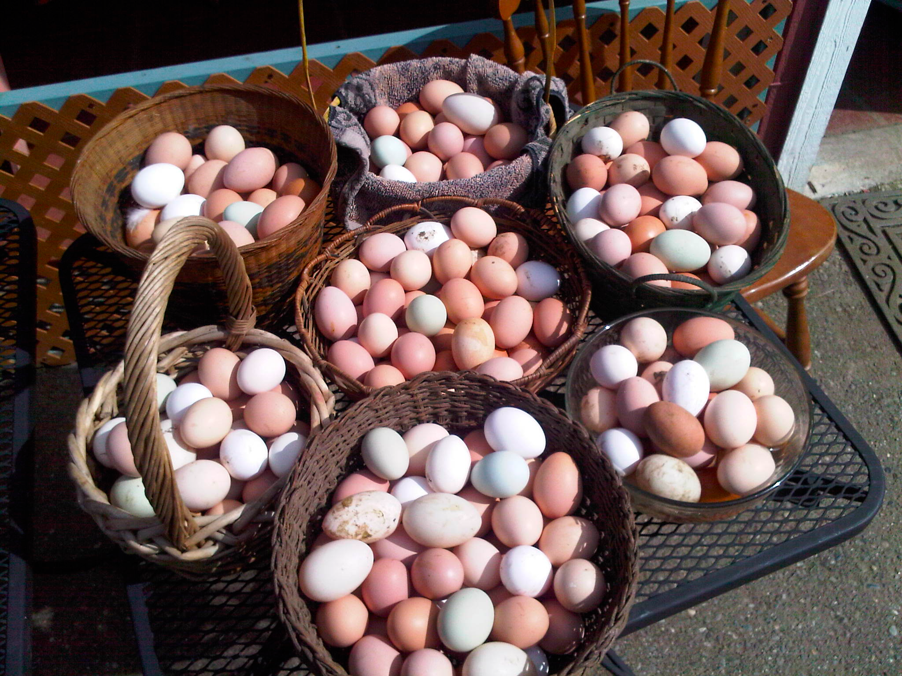
Allelic Diversity
What does it measure?
The average number of alleles per locus (used for multiple loci)
Use it when: You have multiple loci with different numbers of alleles
For a single locus: just count the alleles!
For multiple loci: A= NA/NT
Where:
NA = total number of different alleles
NT = total number of loci examined
Textbook ch4 (p. 73)

Slide 36
Example 3: Allelic diversity
3. We used protein electrophoresis to analyse genetic diversity at 12 loci across 63 platypus, obtaining the following data:
(b) What is the allelic diversity (A)?
Allozyme locus | Allele 1 | Allele 2 | Allele 3 | (Sum) | (Sum P_{i}²) | H_{i}
1 | 0.60 | 0.24 | 0.16 | 1.00 | 0.4432 | 0.5568
2 | 0.63 | 0.17 | 0.10 | 1.00 | 0.4358 | 0.5642
3 | 0.87 | 0.10 | 0.03 | 1.00 | 0.7658 | 0.2322
4 | 0.67 | 0.33 | 0.00 | 1.00 | 0.5578 | 0.4422
5 | 0.76 | 0.14 | 0.00 | 1.00 | 0.5972 | 0.4028
6 | 0.96 | 0.04 | 0.00 | 1.00 | 0.9392 | 0.0768
7 | 1.00 | 0.00 | 0.00 | 1.00 | 1.0000 | 0.0000
8 | 1.00 | 0.00 | 0.00 | 1.00 | 1.0000 | 0.0000
9 | 1.00 | 0.00 | 0.00 | 1.00 | 1.0000 | 0.0000
10 | 1.00 | 0.00 | 0.00 | 1.00 | 1.0000 | 0.0000
11 | 1.00 | 0.00 | 0.00 | 1.00 | 1.0000 | 0.0000
12 | 1.00 | 0.00 | 0.00 | 1.00 | 1.0000 | 0.0000
SUM |  |  |  | 12 |  | 2.275

Slide 37
Example 3: Allelic diversity
Allozyme locus | Allele 1 | Allele 2 | Allele 3 | (Sum) | (Sum P_{i}²) | H_{i}
1 | 0.60 | 0.24 | 0.16 | 1.00 | 0.4432 | 0.5568
2 | 0.63 | 0.17 | 0.10 | 1.00 | 0.4358 | 0.5642
3 | 0.87 | 0.10 | 0.03 | 1.00 | 0.7658 | 0.2322
4 | 0.67 | 0.33 | 0.00 | 1.00 | 0.5578 | 0.4422
5 | 0.76 | 0.14 | 0.00 | 1.00 | 0.5972 | 0.4028
6 | 0.96 | 0.04 | 0.00 | 1.00 | 0.9392 | 0.0768
7 | 1.00 | 0.00 | 0.00 | 1.00 | 1.0000 | 0.0000
8 | 1.00 | 0.00 | 0.00 | 1.00 | 1.0000 | 0.0000
9 | 1.00 | 0.00 | 0.00 | 1.00 | 1.0000 | 0.0000
10 | 1.00 | 0.00 | 0.00 | 1.00 | 1.0000 | 0.0000
11 | 1.00 | 0.00 | 0.00 | 1.00 | 1.0000 | 0.0000
12 | 1.00 | 0.00 | 0.00 | 1.00 | 1.0000 | 0.0000
SUM |  |  |  | 12 |  | 2.275
A= NA/NT =(9+6+6)/12
= 1.75

Slide 38
Genotype and Allele Frequencies
 | Genotype
 | A₁A₁ | A₁A₂ | A₂A₂ | Total
Number of individuals (Genotype numbers) | 37 | 24 | 6 | 67

Slide 39
Genotype and Allele Frequencies
 | Genotype
 | A₁A₁ | A₁A₂ | A₂A₂ | Total
Number of individuals (Genotype numbers) | 37 | 24 | 6 | 67
Genotype frequencies |  |  |  | 1.00

Slide 40
Genotype and Allele Frequencies
 | Genotype
 | A₁A₁ | A₁A₂ | A₂A₂ | Total
Number of individuals (Genotype numbers) | 37 | 24 | 6 | 67
Genotype frequencies |  |  |  | 1.00
Allele frequencies (p & q for 2 alleles)
If p refers to the frequency of A₁, then:

Slide 41
Genotype and Allele Frequencies
 | Genotype
 | A₁A₁ | A₁A₂ | A₂A₂ | Total
Number of individuals (Genotype numbers) | 37 | 24 | 6 | 67
Genotype frequencies |  |  |  | 1.00
Allele frequencies (p & q for 2 alleles)
If p refers to the frequency of A₁, then:
p = (Total count of allele A₁) / (Total number of alleles)

Slide 42
Genotype and Allele Frequencies
 | Genotype
 | A₁A₁ | A₁A₂ | A₂A₂ | Total
Number of individuals (Genotype numbers) | 37 | 24 | 6 | 67
Genotype frequencies |  |  |  | 1.00
Allele frequencies (p & q for 2 alleles)
If p refers to the frequency of A₁, then:
p = (Total count of allele A₁) / (Total number of alleles)
p = [(2 X A₁A₁) + (1 X A₁A₂) ] / (2 X 67)
p = [(2 X 37) + 24] / 134 = 0.731

Slide 43
Genotype and Allele Frequencies
 | Genotype
 | A₁A₁ | A₁A₂ | A₂A₂ | Total
Number of individuals (Genotype numbers) | 37 | 24 | 6 | 67
Genotype frequencies |  |  |  | 1.00
Allele frequencies (p & q for 2 alleles)
If q refers to the frequency of A₂, then:
q = [(2 X A₂A₂) + (1 X A₁A₂) ] / (2 X 67)
q = [(2 X 6) + 24] / 134 = 0.269

Slide 44
Genotype and Allele Frequencies
 | Genotype
 | A₁A₁ | A₁A₂ | A₂A₂ | Total
Number of individuals (Genotype numbers) | 37 | 24 | 6 | 67
Genotype frequencies |  |  |  | 1.00
Allele frequencies (p & q for 2 alleles)
If q refers to the frequency of A₂, then:
q = [(2 X A₂A₂) + (1 X A₁A₂) ] / (2 X 67)
q = [(2 X 6) + 24] / 134 = 0.269
…or the shorthand version! q = (1 – p)

Slide 45
Hardy-Weinberg Equilibrium
What you need to calculate:
Genotype numbers (OBS) – usually given
Allele frequencies (OBS)
Genotype frequencies (EXP) using the calculated allele frequencies in the HWE formula (p², 2pq, q²)
Transform the EXP frequencies into EXP numbers
Compare OBS numbers (1) to EXP numbers (4) using chi sq.
 | Genotypes
 | A₁A₁ | A₁A₂ | A₂A₂ | Total
Number of individuals (Genotype numbers) | 37 | 24 | 6 | 67
Genotype frequencies |  |  |  | 1.00
p = [(2 X 37) + 24] / 134 = 0.731
q = [(2 X 6) + 24] / 134 = 0.269
Must equal 1

Slide 46
Hardy-Weinberg Equilibrium
 | Genotypes
 | A₁A₁ | A₁A₂ | A₂A₂ | SUM
Observed number of individuals | 37 | 24 | 6 | 67
H-W expected frequencies | P² | 2pq | q²
H-W expected number of individuals

Slide 47
Hardy-Weinberg Equilibrium
 | Genotypes
 | A₁A₁ | A₁A₂ | A₂A₂ | SUM
Observed number of individuals | 37 | 24 | 6 | 67
H-W expected frequencies | P² | 2pq | q² | 1.00
 | 0.73² | 2(0.73 x 0.27) | 0.27²
 | 0.5329 | 0.3942 | 0.0729
H-W expected number of individuals

Slide 48
Hardy-Weinberg Equilibrium
What you need to calculate:
Genotype numbers (OBS) – usually given
Allele frequencies (OBS)
Genotype frequencies (EXP) using the calculated allele frequencies in the HWE formula (p², 2pq, q²)
Transform the EXP frequencies into EXP numbers
Transform the EXP frequencies into EXP numbers
Compare OBS numbers (1) to EXP numbers (4) using chi sq.

Slide 49
Hardy-Weinberg Equilibrium
 | Genotypes
 | A₁A₁ | A₁A₂ | A₂A₂ | SUM
Observed number of individuals | 37 | 24 | 6 | 67
H-W expected frequencies | P² | 2pq | q² | 1.00
 | 0.73² | 2(0.73 x 0.27) | 0.27²
 | 0.5329 | 0.3942 | 0.0729
H-W expected number of individuals | 0.5329 x 67 | 0.3942 x 67 | 0.0729 x 67 | 67
 | 35.7 | 26.4 | 4.9

Slide 50
Hardy-Weinberg Equilibrium
 | Genotypes
 | A₁A₁ | A₁A₂ | A₂A₂ | SUM
Observed number of individuals | 37 | 24 | 6 | 67
H-W expected frequencies | P² | 2pq | q² | 1.00
 | 0.73² | 2(0.73 x 0.27) | 0.27²
 | 0.5329 | 0.3942 | 0.0729
H-W expected number of individuals | 0.5329 x 67 | 0.3942 x 67 | 0.0729 x 67 | 67
 | 35.7 | 26.4 | 4.9
Obs & Exp counts “look” similar, but we need to Statistically test for departure…

Slide 51
Hardy-Weinberg Equilibrium
What you need to calculate:
Genotype numbers (OBS) – usually given
Allele frequencies (OBS)
Genotype frequencies (EXP) using the calculated allele frequencies in the HWE formula (p², 2pq, q²)
Transform the EXP frequencies into EXP numbers
Compare OBS numbers (1) to EXP numbers (4) using chi sq.
Transform the EXP frequencies into EXP numbers
Compare OBS numbers (1) to EXP numbers (4) using chi sq.

Slide 52
Testing H-W Equilibrium:
Genotype | Obs | Exp | (obs-exp)²/exp
A₁A₁ | 37 | 35.7
A₁A₂ | 24 | 26.4
A₂A₂ | 6 | 4.9
Sum | 67 | 67

Slide 53
Testing H-W Equilibrium:
Genotype | Obs | Exp | (obs-exp)²/exp
A₁A₁ | 37 | 35.7 | 0.047
A₁A₂ | 24 | 26.4 | 0.218
A₂A₂ | 6 | 4.9 | 0.247
Sum | 67 | 67 | 0.512

Slide 54
χ² Test: Degrees of Freedom
Ordinary chi-square tests:
Number of categories tested - 1
HWE chi-square tests:
(Number of genotypes tested - 1) - (Number of alleles at the locus tested -1)
This is because these questions have two types of categories that are interdependent: genotypes and alleles, so we need to minus one from each category.
A simpler way to calculate this and get the same result:
Df = Number of genotypes - Number of alleles

Slide 55
Chi squared table
χ² = 0.512, P > 0.05
No evidence for significant departure

Slide 56
Testing H-W Equilibrium:
Genotype | Obs | Exp | (obs-exp)²/exp
A₁A₁ | 37 | 35.7 | 0.047
A₁A₂ | 24 | 26.4 | 0.218
A₂A₂ | 6 | 4.9 | 0.247
Sum | 67 | 67 | 0.512
χ₁² = 0.512, P > 0.05: No evidence for significant departure

Slide 57
Estimating recessive alleles (using phenotype data)
If complete dominance at a locus (Aa), then AA and Aa are phenotypically indistinguishable.
Can’t use traditional allele counting, but we can estimate q:
Genotypes: | AA and Aa | aa
 | p² + 2pq | q²
Phenotypes: | Red | Blue
Frequency: | 0.9704 | 0.0296

Slide 58
Estimating recessive alleles
If complete dominance at a locus (Aa), then AA and Aa are phenotypically indistinguishable.
Can’t use traditional allele counting, but we can estimate q:
In this case:
q² = 0.0296
Genotypes: | AA and Aa | aa
 | p² + 2pq | q²
Phenotypes: | Red | Blue
Frequency: | 0.9704 | 0.0296

Slide 59
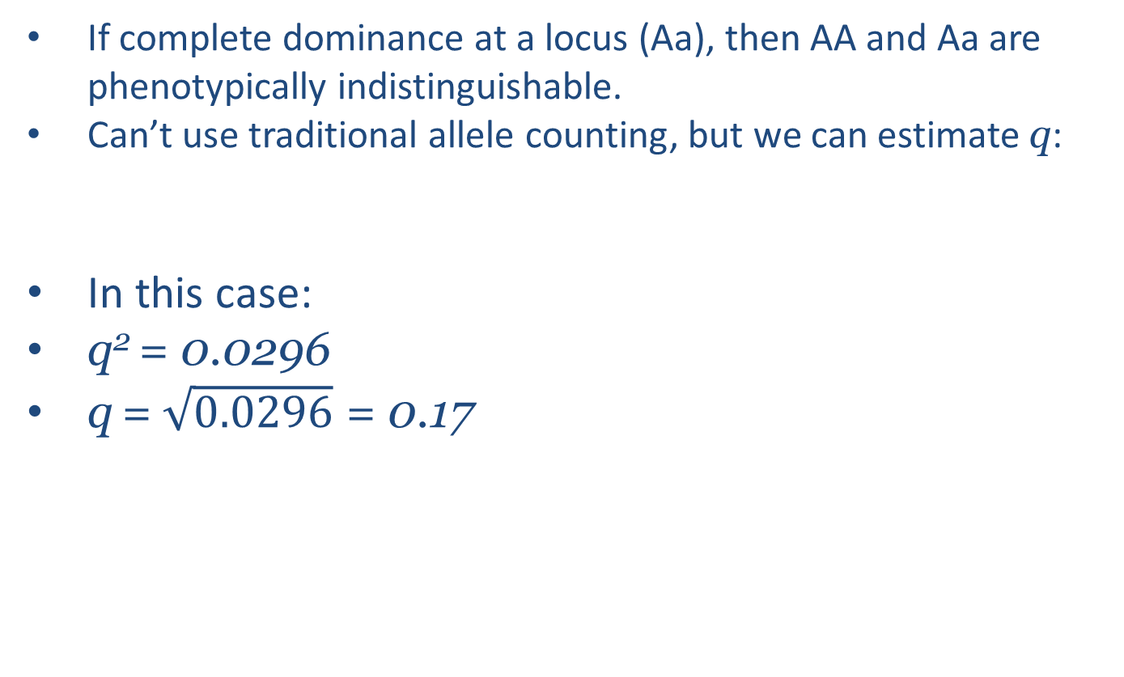
Estimating recessive alleles
If complete dominance at a locus (Aa), then AA and Aa are phenotypically indistinguishable.
Can’t use traditional allele counting, but we can estimate q:
In this case:
q² = 0.0296
q = $\sqrt{0.0296}$ = 0.17
Genotypes: | AA and Aa | aa
 | p² + 2pq | q²
Phenotypes: | Red | Blue
Frequency: | 0.9704 | 0.0296

Slide 60
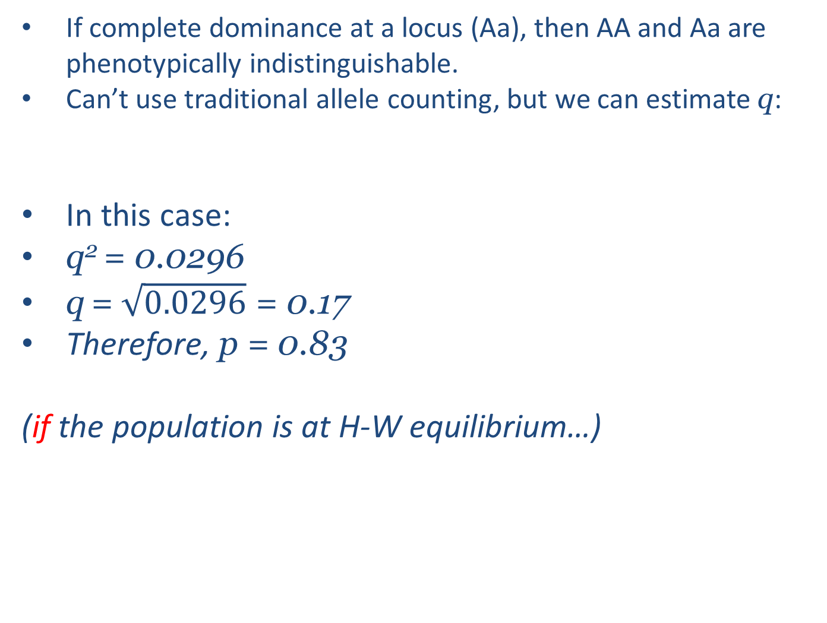
Estimating recessive alleles
If complete dominance at a locus (Aa), then AA and Aa are phenotypically indistinguishable.
Can’t use traditional allele counting, but we can estimate q:
In this case:
q² = 0.0296
q = $\sqrt{0.0296}$ = 0.17
Therefore, p = 0.83
(if the population is at H-W equilibrium…)
Genotypes: | AA and Aa | aa
 | p² + 2pq | q²
Phenotypes: | Red | Blue
Frequency: | 0.9704 | 0.0296

Slide 61
H-W Equilibrium for >2 alleles
A₁ (p) A₂ (q) | Genotypes
 | A₁A₁ | A₁A₂ | A₂A₂
 | p² | 2pq | q²
A₁ (p) A₂ (q) A₃ (r) | Genotypes
 | A₁A₁ | A₁A₂ | A₁A₃ | A₂A₂ | A₂A₃ | A₃A₃
 | p² | 2pq | 2pr | q² | 2qr | r²

Slide 62
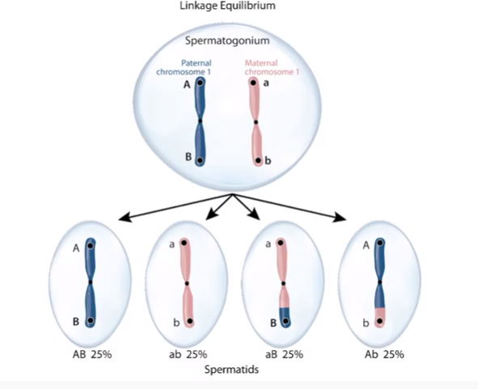
Linkage Disequilibrium (D)
Greater distance between alleles on the same chromosome
Higher chance of independent assortment of alleles

Slide 63
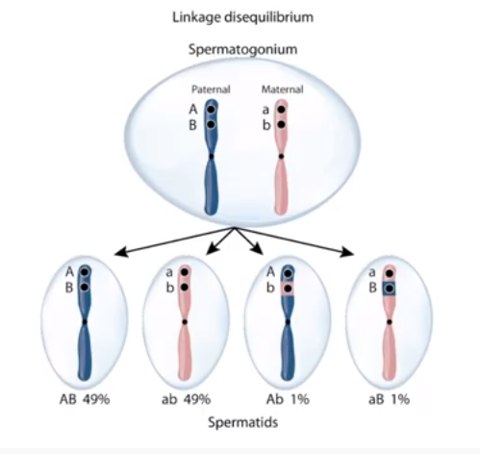
Linkage Disequilibrium (D)
Smaller distance between alleles on the same chromosome
Lower chance of independent assortment of alleles.

Slide 64
Linkage Disequilibrium (D)
What does it measure?
The amount of association between different alleles in gametic types (haplotypes).
What is it?
Genes in close proximity on the same chromosome are more likely to be inherited together.
Why should you care?
Greater D can indicate population level processes.

Slide 65
Linkage Disequilibrium (D)

Slide 66
Calculation: for 2 locus with 2 alleles:
$$D=\left(r x u\right)−(s x t)$$
Where:
r = rel freq of A₁B₁
s = rel freq of A₁B₂
t = rel freq of A₂B₁
u = rel freq of A₂B₂
In this case, no linkage = 0, maximum D deviates from zero up to a maximum of ± 0.25
(any deviation from 0, whether +positive or -negative)

Slide 67
Example 1: For two loci each with two segregating alleles, we find the following distribution of gametic types (haplotypes). What is D?
A₁B₁ | A₁B₂ | A₂B₁ | A₂B₂
0.318 | 0.212 | 0.082 | 0.388

Slide 68
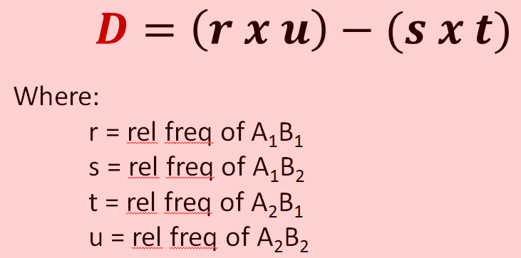
Example 1: For two loci each with two segregating alleles, we find the following distribution of gametic types (haplotypes). What is D?
A₁B₁ | A₁B₂ | A₂B₁ | A₂B₂
0.318 | 0.212 | 0.082 | 0.388
r | s | t | u

Slide 69
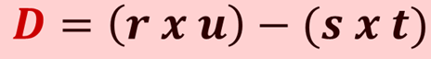
A₁B₁ | A₁B₂ | A₂B₁ | A₂B₂
0.318 | 0.212 | 0.082 | 0.388
r | s | t | u
D = ( 0.318 x 0.388) – (0.212 x 0.082)
= 0.123 – 0.0174
= 0.1056

Slide 70
Example 2: For two loci each with two segregating alleles, what frequencies would give maximum D?
A₁B₁ | A₁B₂ | A₂B₁ | A₂B₂
r | s | t | u

Slide 71
Example 2: For two loci each with two segregating alleles, what frequencies would give maximum D?
A₁B₁ | A₁B₂ | A₂B₁ | A₂B₂
0.5 | 0 | 0 | 0.5
r | s | t | u
D = ( 0.5 x 0.5) – (0 x 0) = 0.25
Meaning?

Slide 72
Example 2: For two loci each with two segregating alleles, what frequencies would give maximum D?
A₁B₁ | A₁B₂ | A₂B₁ | A₂B₂
0.5 | 0 | 0 | 0.5
r | s | t | u
D = ( 0.5 x 0.5) – (0 x 0) = 0.25
Meaning?
Zero recombination!

Slide 73
Summary – Tute 1
Revision:
Punnet Squares
DNAs and RNAs
Chi square
IUCN Red list website
Linkage D
New content:
Polymorphism Frequencies
Expected Heterozygosity
Average Heterozygosity
Allelic Diversity
Allele counting
H-W equilibrium

